Slide 1
AI in Health
Ying Ding
AI Health Lab
School of Information
Dell Medical School

Slide 2
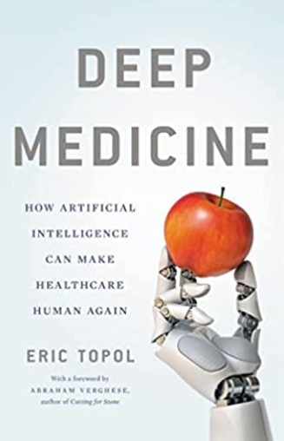
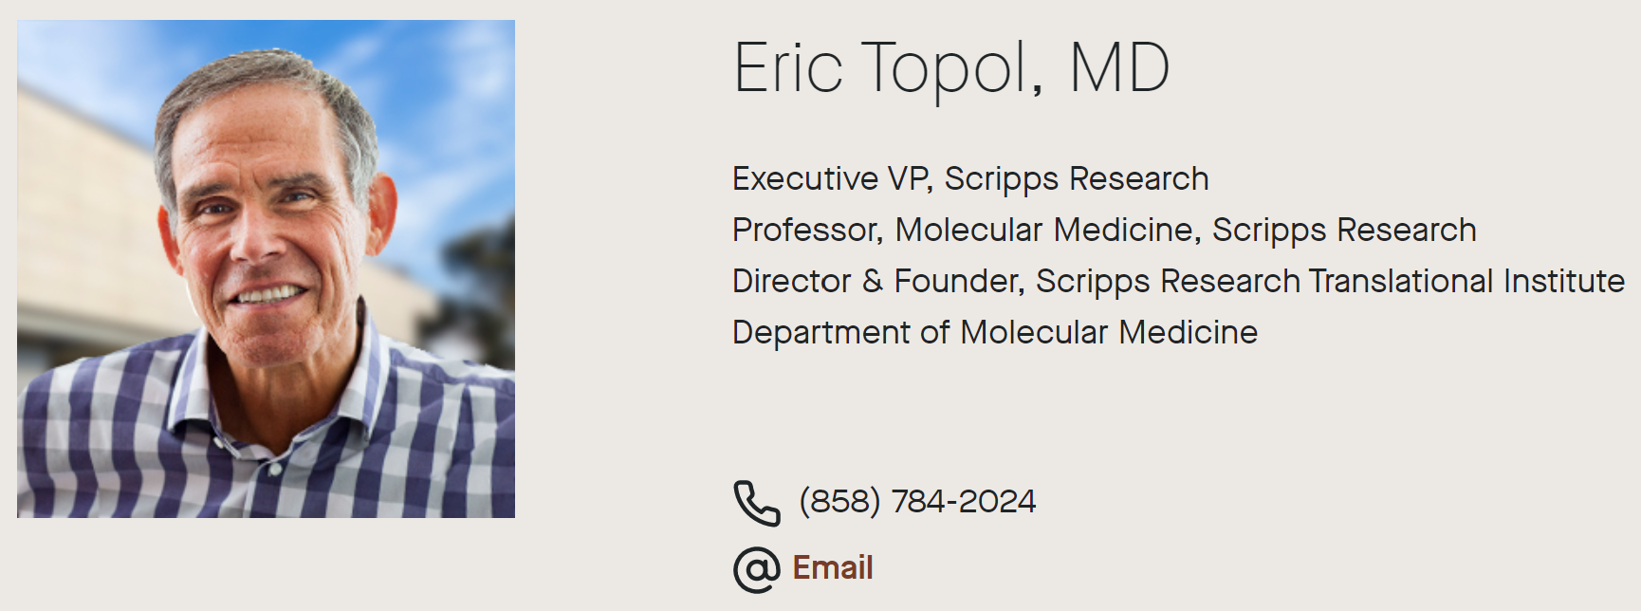
Outlandish Expectations for AI in Healthcare
Outperform doctors at all tasks
Diagnose the undiagnosable
Treat the untreatable
See the unseeable on scans, slides
Predict the unpredictable
Classify the unclassifiable
Eliminate workflow inefficiencies
Eliminate hospital admissions and readmissions
Eliminate the surfeit of unnecessary jobs
100% medication adherence
Zero patient harm
Cure cancer
Eric Topol, Deep Medicine, 2019

Slide 3
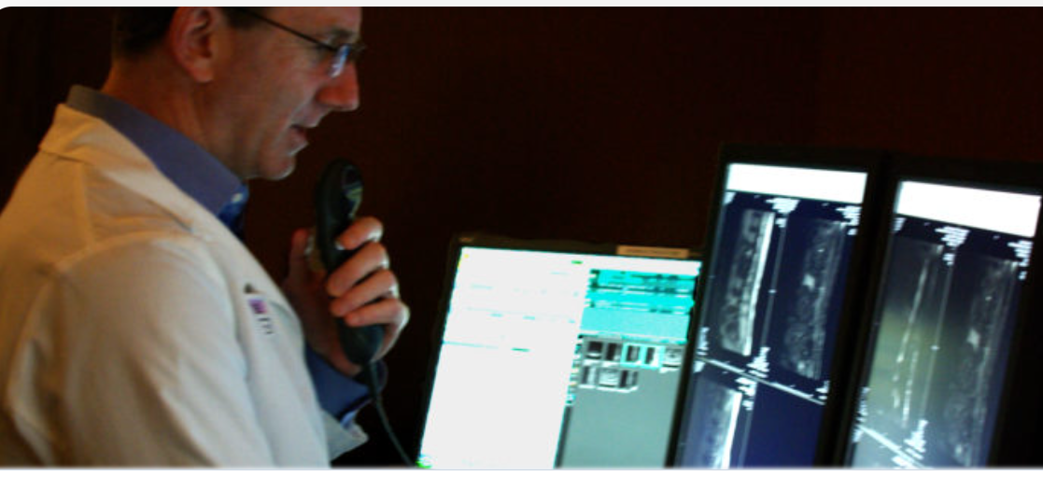
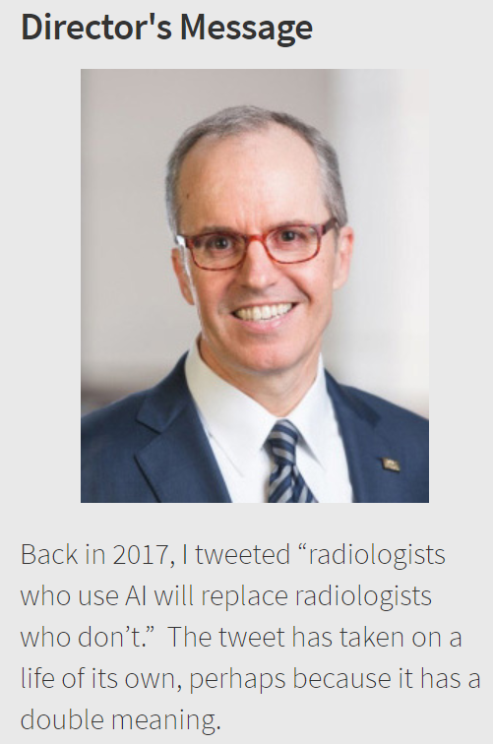
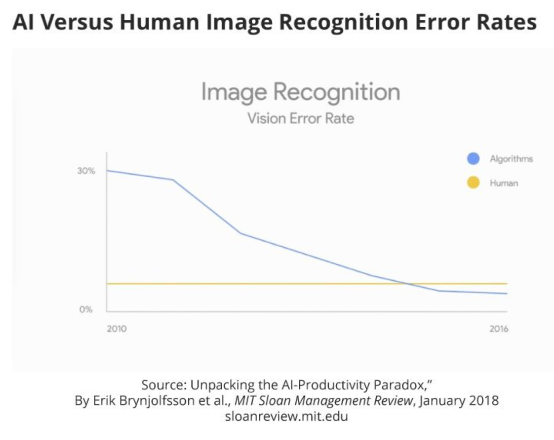
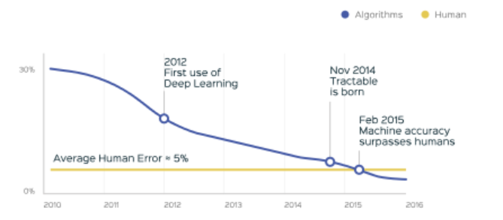
Too fast, or too late
Many doctors complain that things are moving too fast, but the pace of AI in health has grown exponentially. If you do not deal with it now, it will be too late.
The message also intends to promote the idea that all radiologists will eventually adopt AI, thereby replacing their former selves. But regardless of which replacement scenario seems more likely, no one doubts that AI will transform how imaging professionals practice medicine.
With estimates of average diagnostic error rates ranging from 3% to 5%, there are approximately 40 million diagnostic errors involving imaging annually worldwide.
Curt Langlotz, Director of AI in health and imaging at Stanford

Slide 4
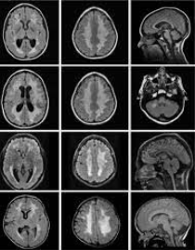
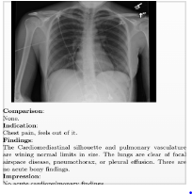
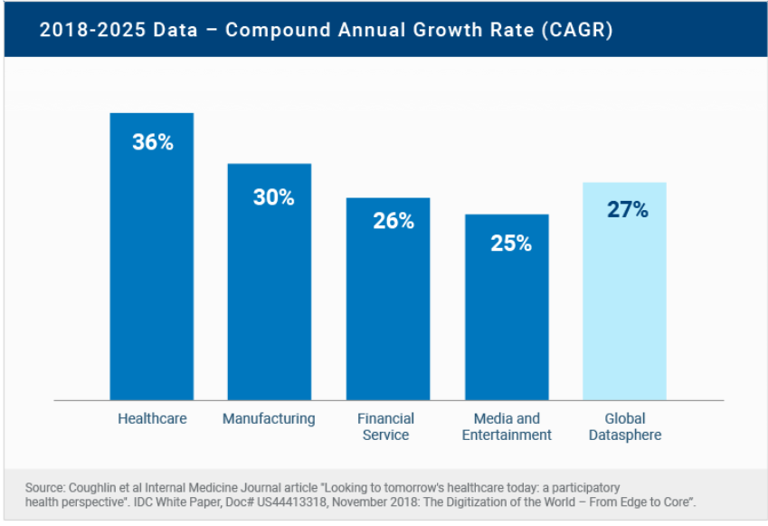
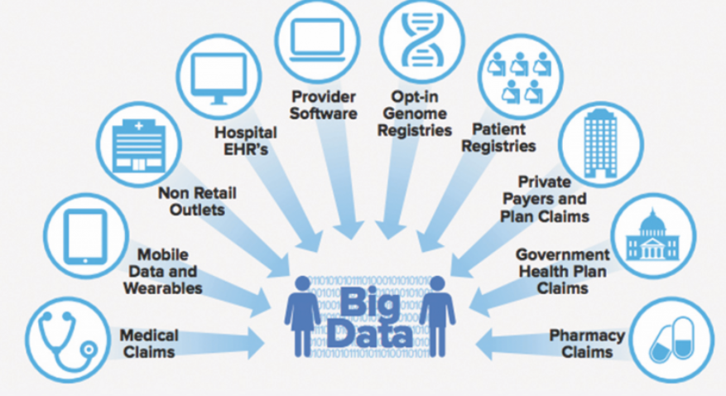
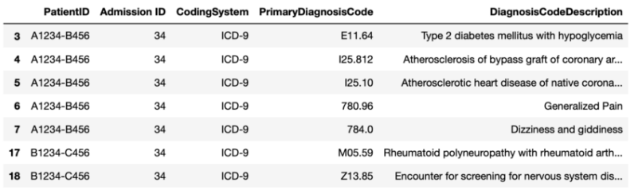
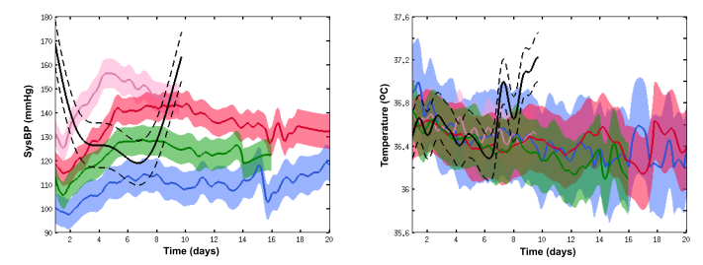
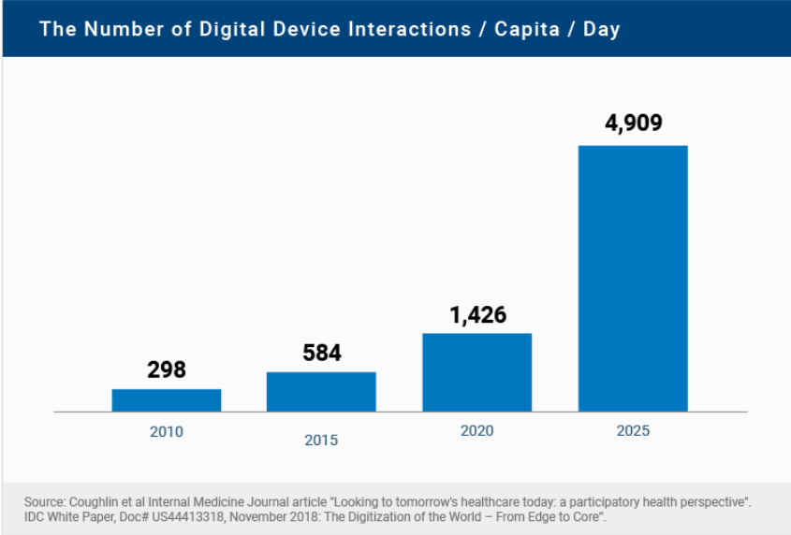

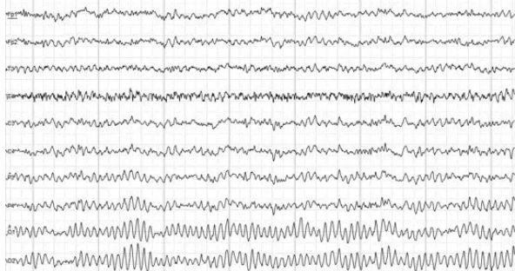
Healthcare Data World

Slide 5
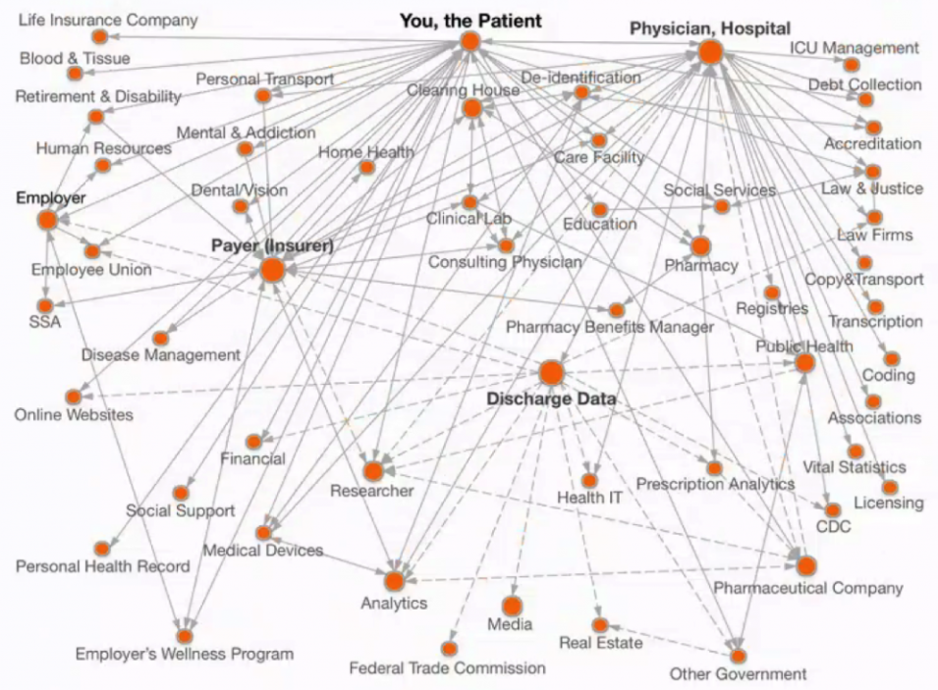
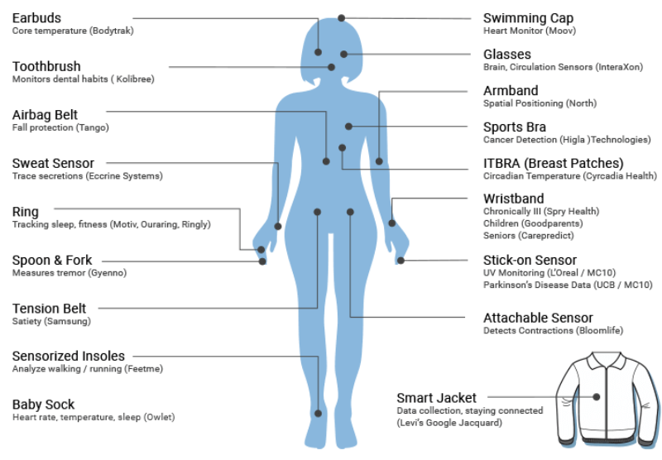
Patient-Centered Digital Footprints
https://tcf.org/content/report/strengthening-protection-patient-medical-data/?agreed=1
The Health Data Explosion at https://www.rbccm.com/

Slide 6
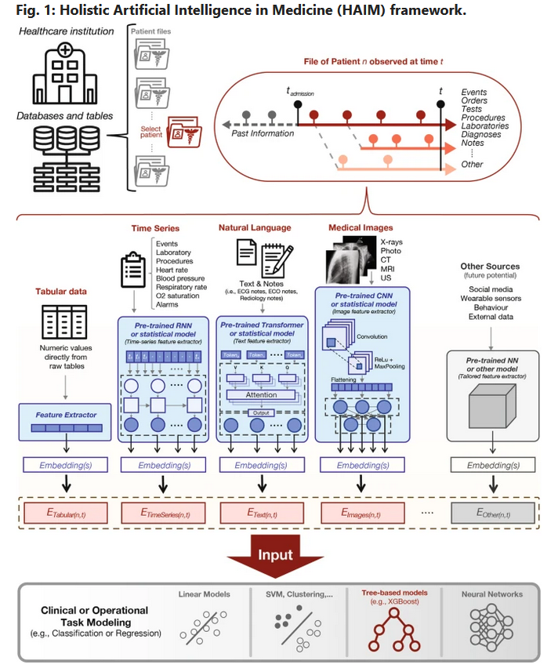
Deep Learning: The best way to deal with complex cross modality healthcare data
https://www.nature.com/articles/s41746-022-00689-4#citeas

Slide 7
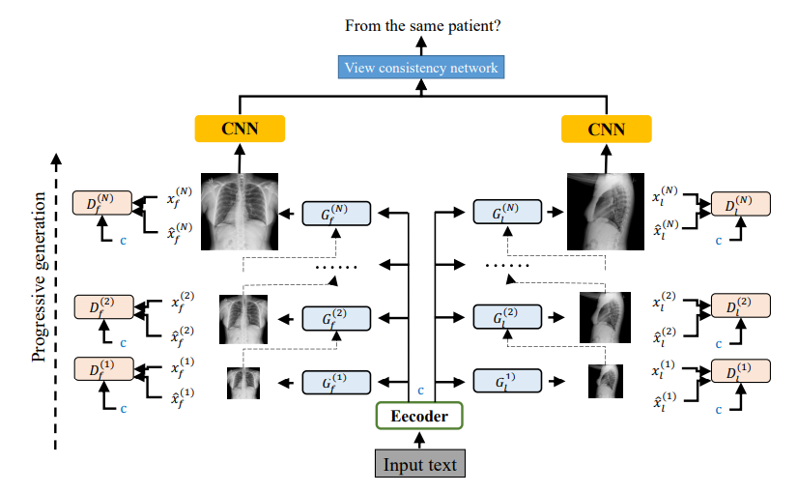
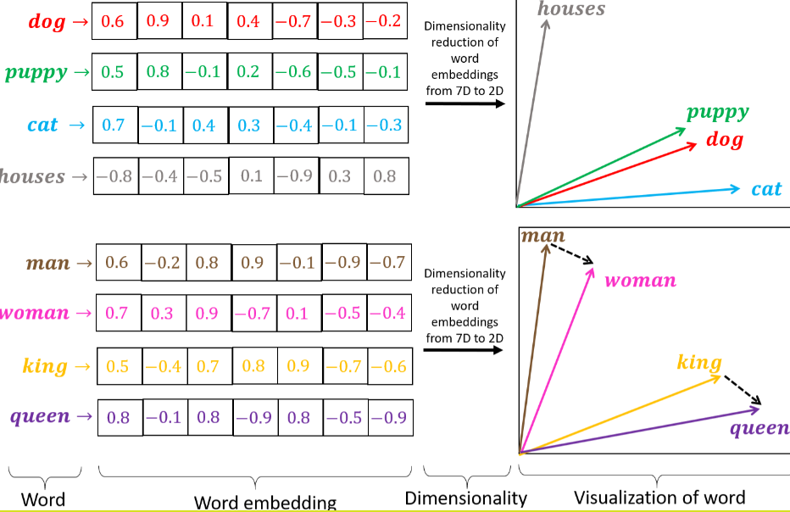
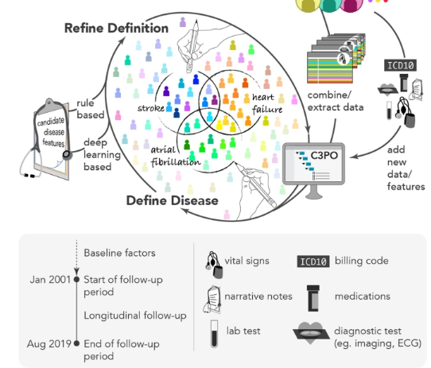
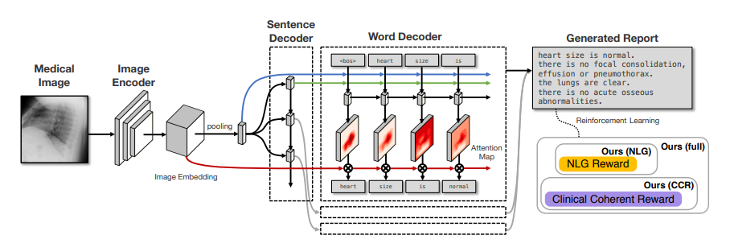
Embedding is the magic language for AI
https://arxiv.org/pdf/2006.10552v1.pdf
https://arxiv.org/pdf/1904.02633.pdf
https://www.nature.com/articles/s41746-022-00590-0

Slide 8
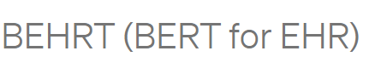
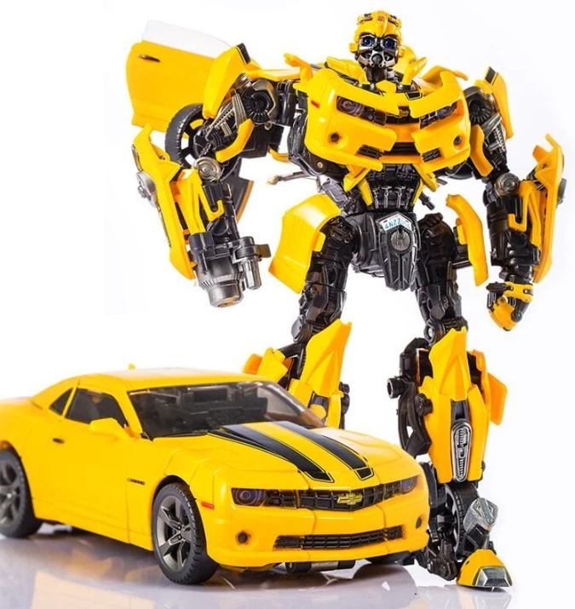
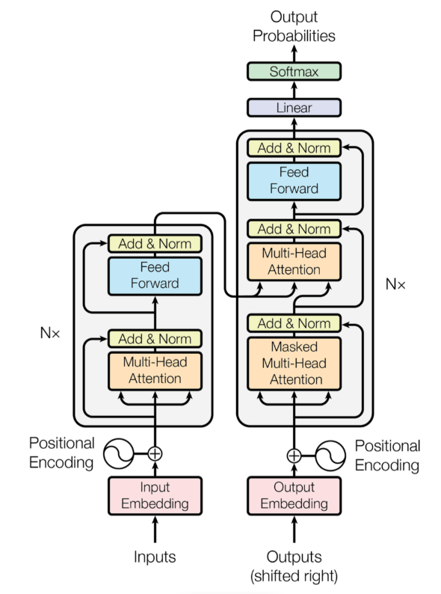
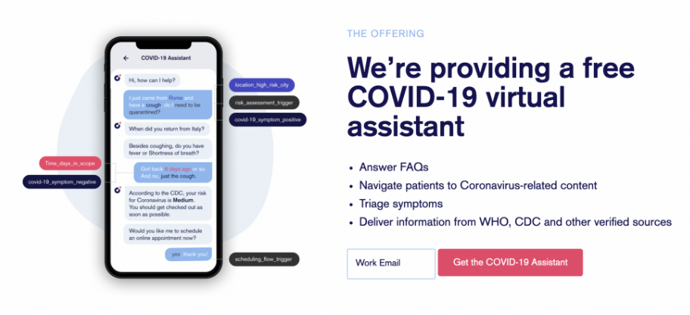
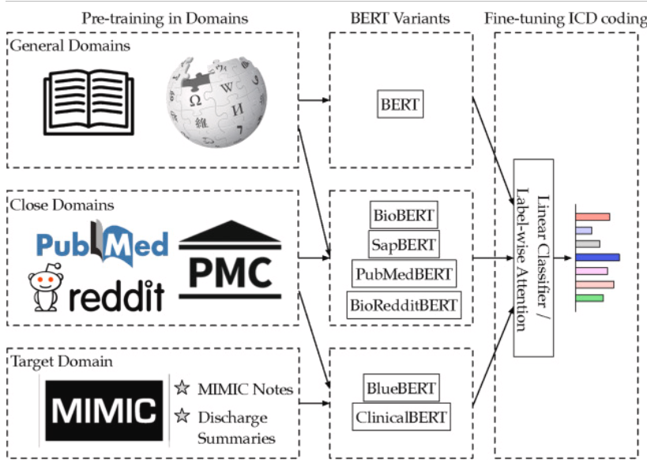
Transformer: the Power of AI
Theory: adopting the mechanism of self-attention, weighting the significance of each part of the input data.
Project December: GPT-3 to create hyper-realistic chatbots
Health Risk Prediction: Predicting the end of life, surgical procedure (surgery), the probability of hospitalization

Slide 9
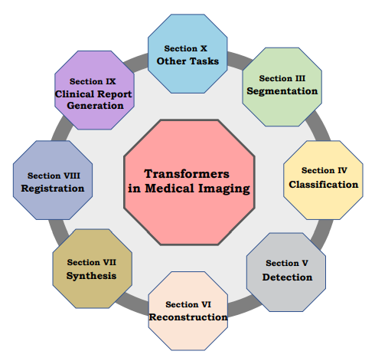
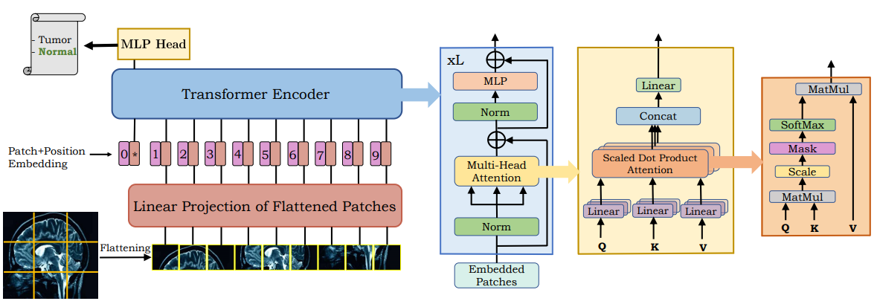
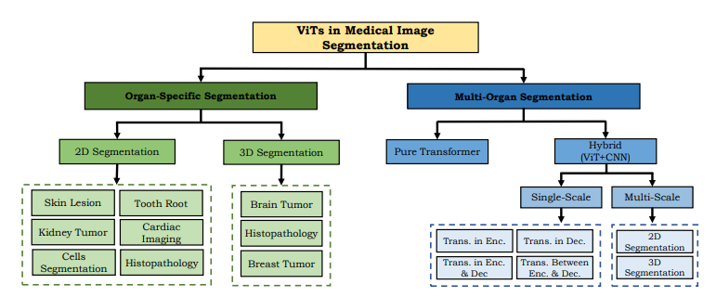
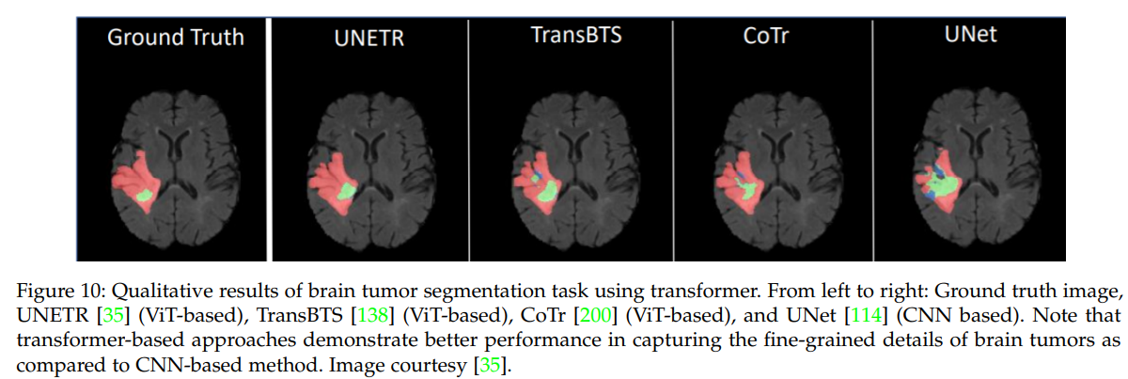
Transformer: the Power of AI
https://arxiv.org/pdf/2201.09873.pdf
https://arxiv.org/abs/2010.11929

Slide 10
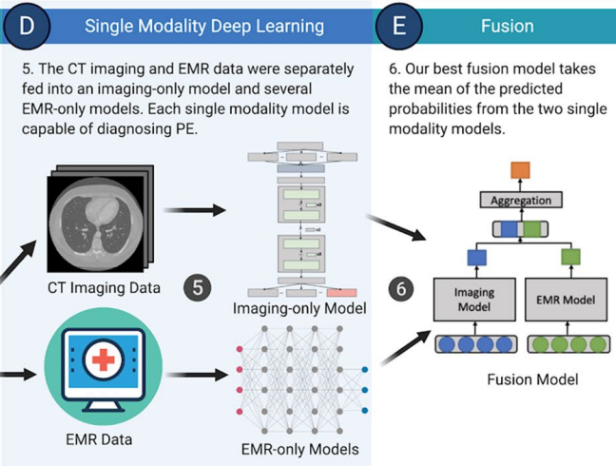
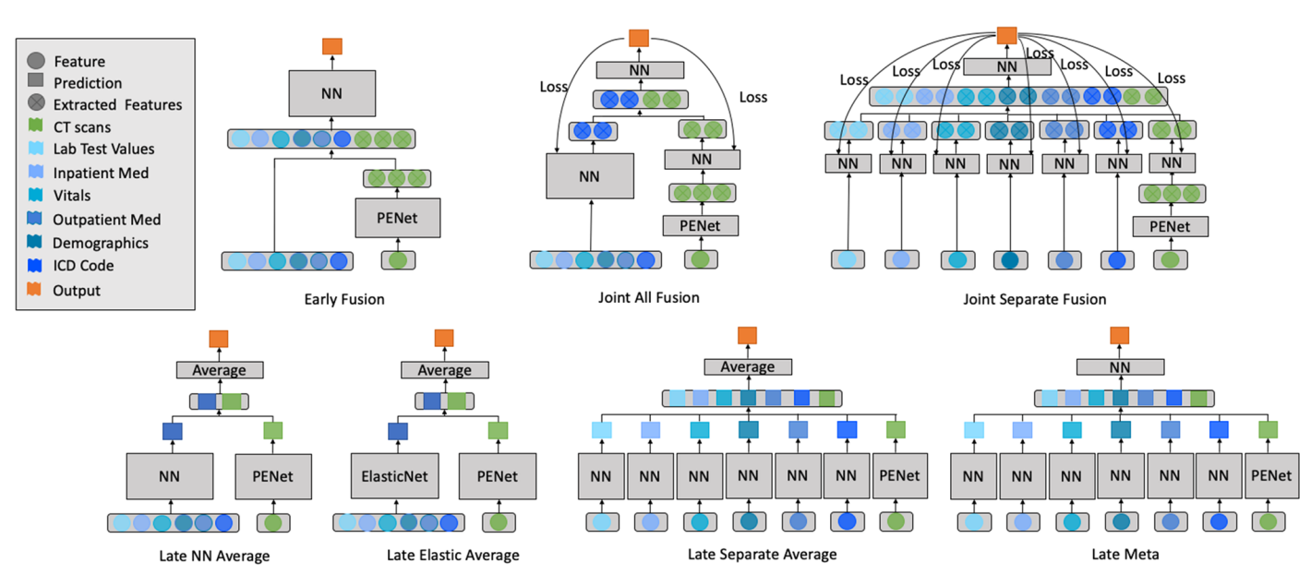
Multimodal Fusion Learning
Multimodal fusion model architectures that are capable of utilizing both pixel data from volumetric Computed Tomography Pulmonary Angiography(CTPA) scans and clinical patient data from the EMR to automatically classify Pulmonary Embolism (PE) cases. The best performing multimodality model is a late fusion model that achieves an AUROC of 0.947, outperforming imaging-only and EMR-only single modality models.
https://www.nature.com/articles/s41598-020-78888-w

Slide 11
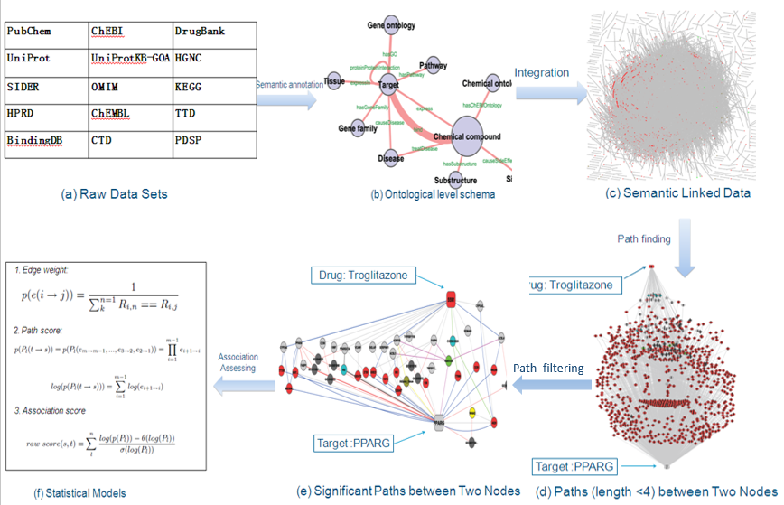
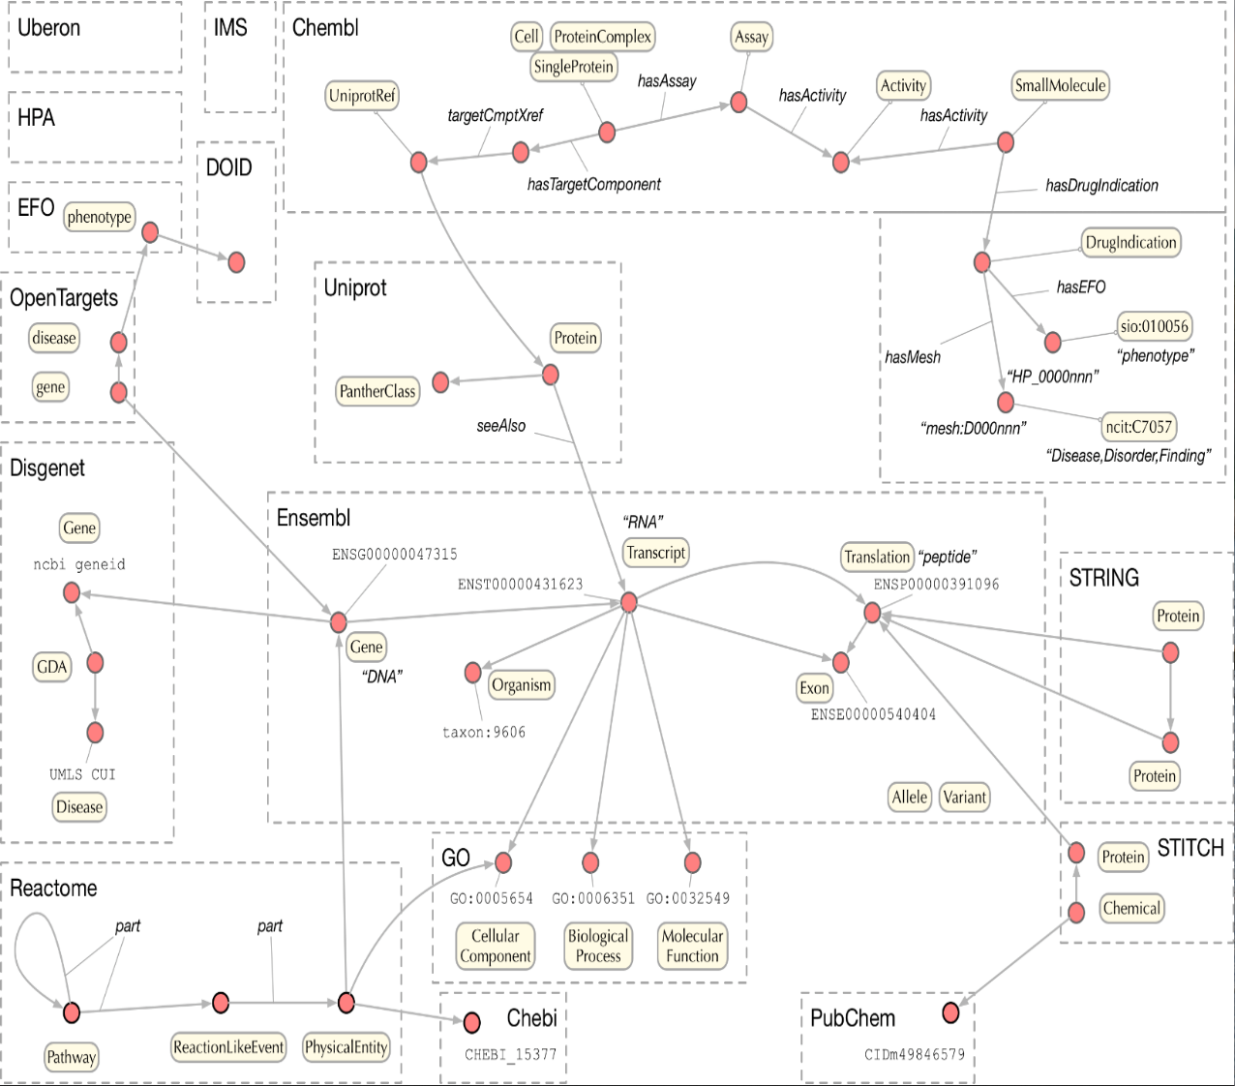
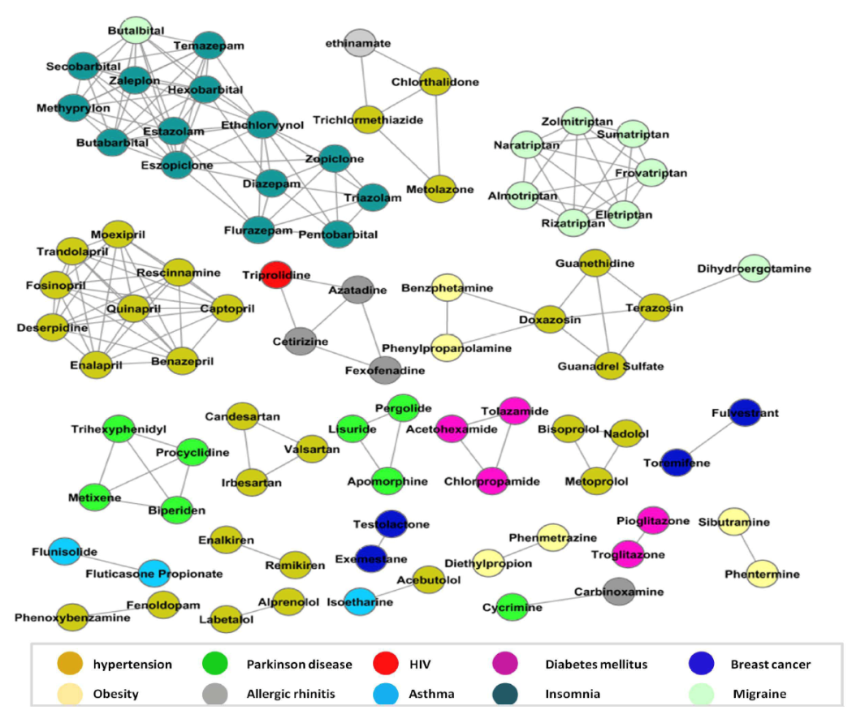
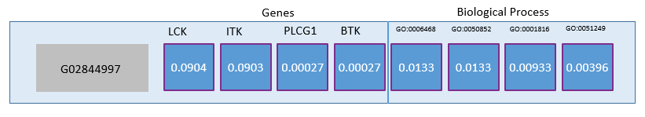
Knowledge Graph: The Connected Health
https://journals.plos.org/ploscompbiol/article?id=10.1371/journal.pcbi.1002574
https://bmcbioinformatics.biomedcentral.com/articles/10.1186/s12859-019-2914-2

Slide 12
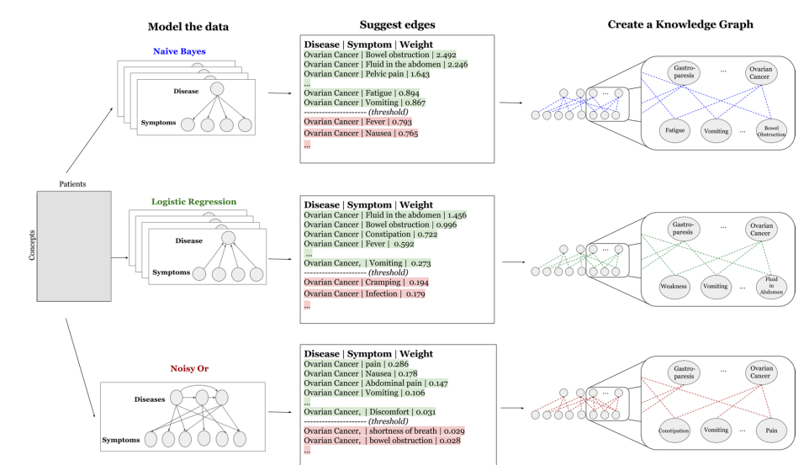
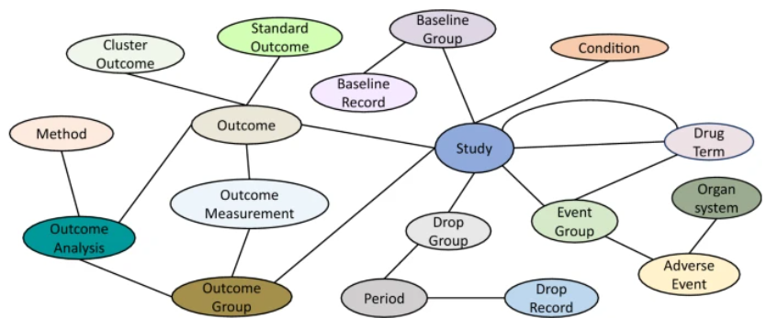
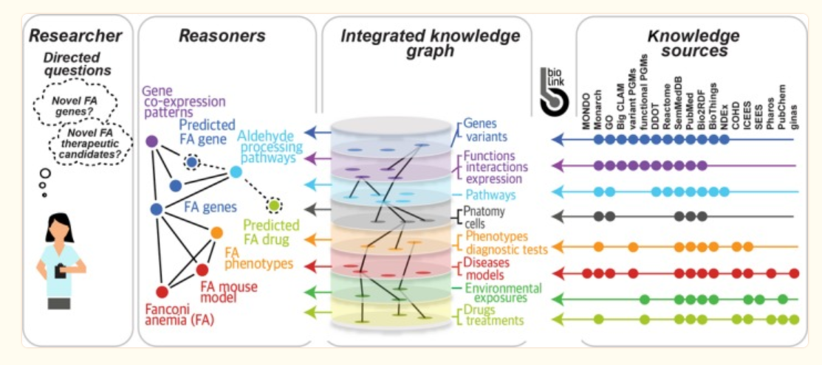
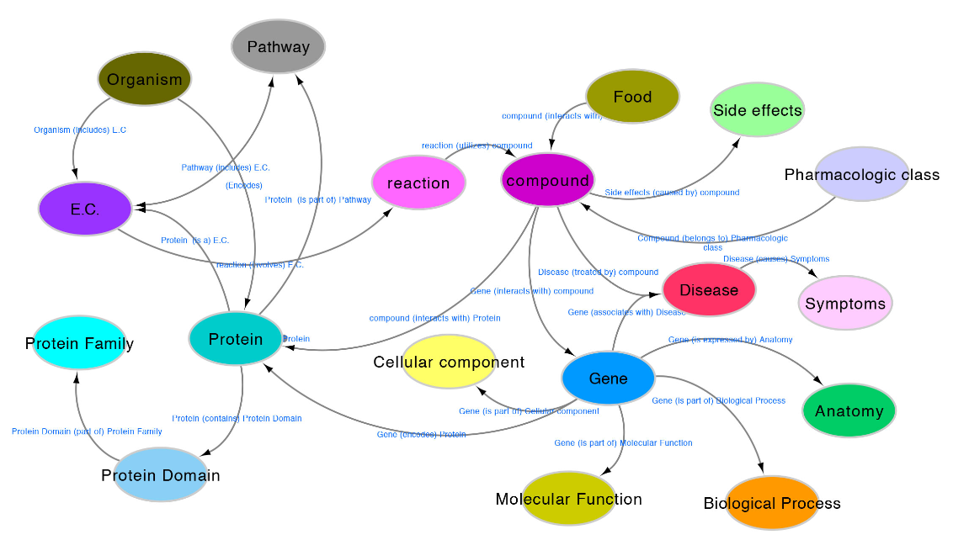
Knowledge Graph: The Connected Health
Clinical Trail KG: https://github.com/ninglab/CTKG
Disease-Symptom KG: https://www.nature.com/articles/s41598-017-05778-z
NIH-NCATS: Biomedical data translator: https://www.ncbi.nlm.nih.gov/pmc/articles/PMC6440568/
SPOKE: https://spoke.ucsf.edu/

Slide 13
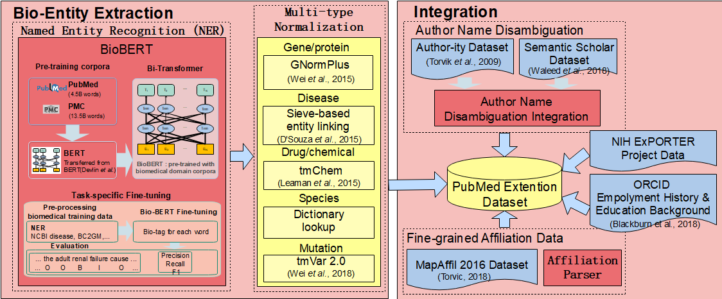
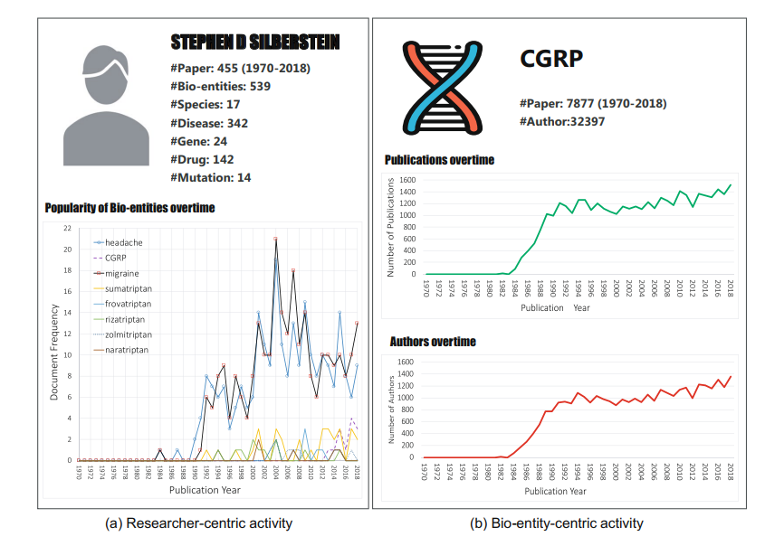
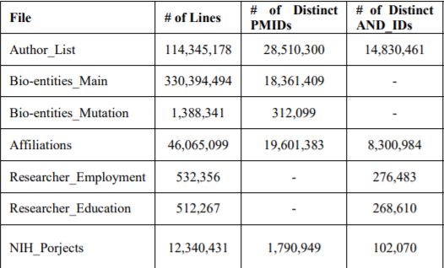
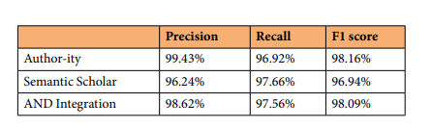
Knowledge Graph about PubMed
https://www.nature.com/articles/s41597-020-0543-2
Graph convolutional neural network for bigger graphs (pre-clinical+clinical+PubMed)

Slide 14
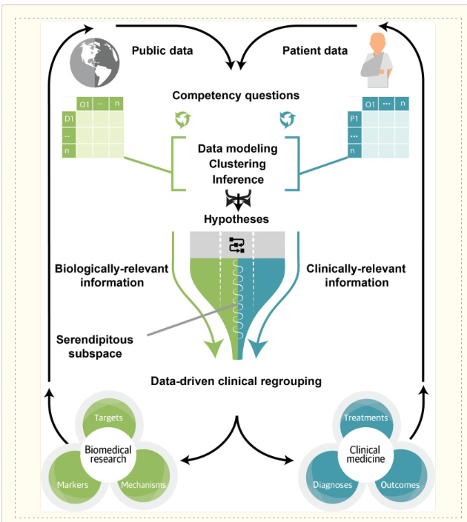
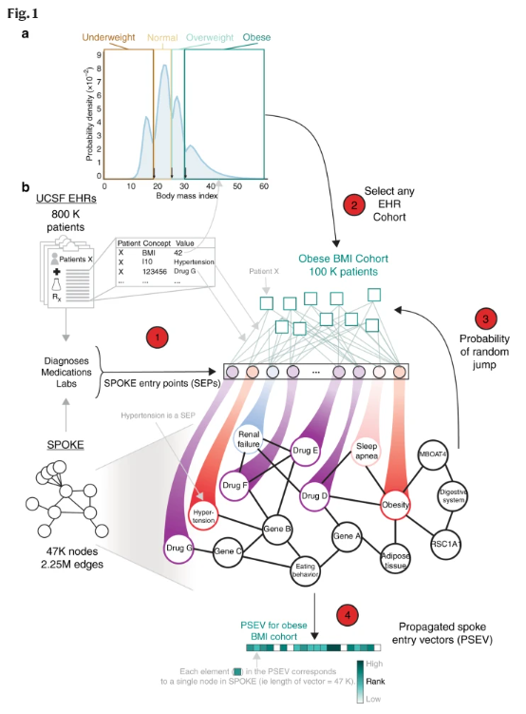
Closed Loop of Pre-clinical and Clinical Data
https://www.ncbi.nlm.nih.gov/pmc/articles/PMC6440568/
https://www.nature.com/articles/s41467-019-11069-0

Slide 15
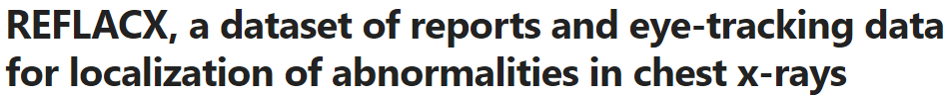
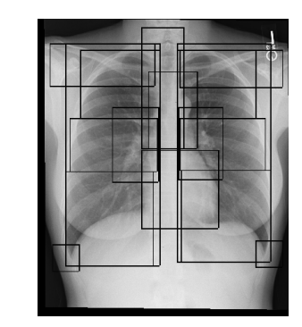
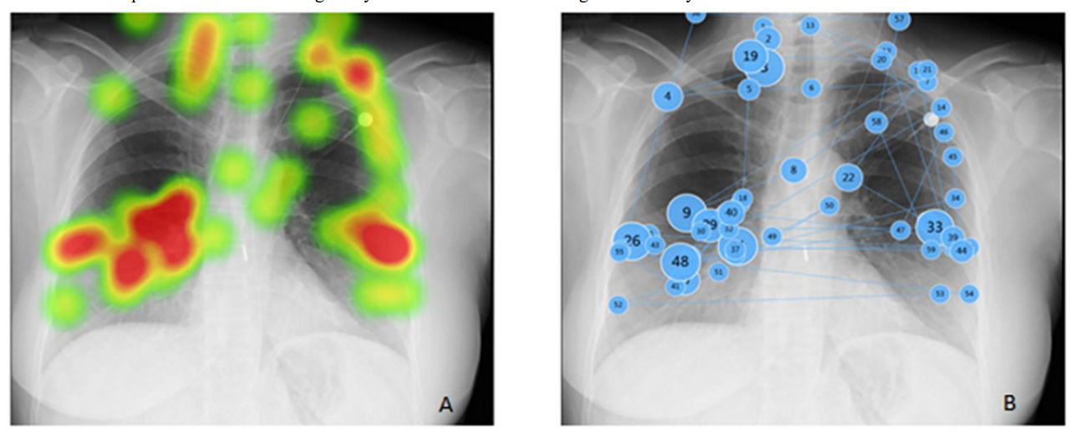
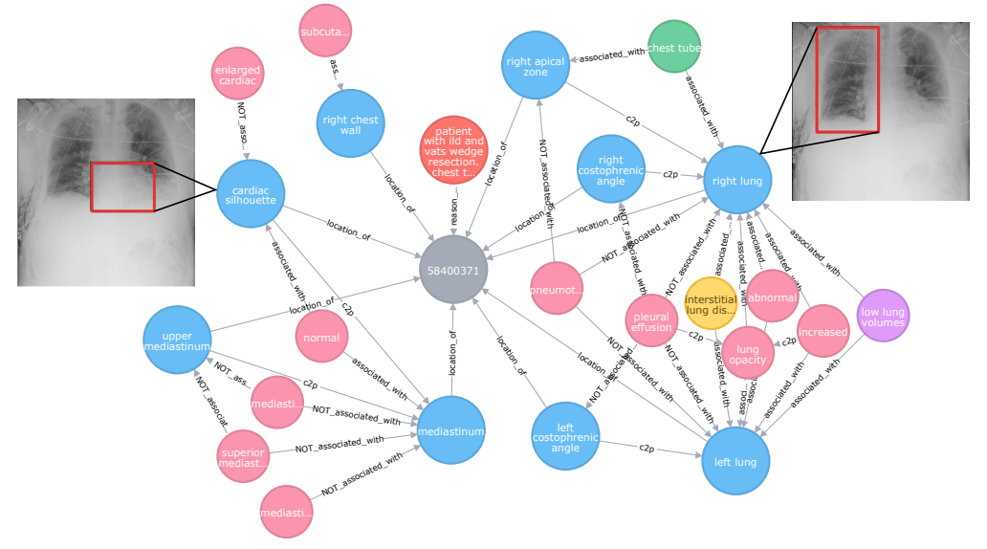


Knowledge Graph in Chest X-Ray
https://www.nature.com/articles/s41597-022-01441-z
https://arxiv.org/pdf/2108.00316.pdf
https://openaccess.thecvf.com/content/WACV2022/papers/Han_Knowledge-Augmented_Contrastive_Learning_for_Abnormality_Classification_and_Localization_in_Chest_WACV_2022_paper.pdf

Slide 16




Research Highlight: Human-Centered AI for Medical Imaging Diagnosis
Project goals:
Develop the novel methods to add doctors’ prior knowledge to enable better human-centered AI approaches for medical imaging diagnosis
Develop novel contrastive learning methods by proposing using patient metadata as data augmentation methods to generate positive samples for a given image.
Barriers: adding radiologist’s prior knowledge (radiomics) into deep learning methods is challenging.
Output: Our ChexRadiNet outperforms the state-of-the-art on both disease detection (0.843 in AUC) and localization (0.679 in T(IoU) = 0.1). SCALP outperforms existing baselines with significant margins in both classification and localization tasks. Specifically, the average classification AUCs improve from 82.8% (SOTA using DenseNet-121) to 83.9% (SCALP using ResNet-50), while the localization results improve on average by 3.7% over different IoU thresholds
Han, Y., Chen, C., Tewfik, A., Glicksberg, B., Ding, Y., Peng, Y., & Wang, Z. (2022). Knowledge-Augmented Contrastive Learning for Abnormality Classification and Localization in Chest X-rays with Radiomics using a Feedback Loop. WACV2022
Jaiswal, A., Li, H., Zander, C., Han, Y., Rousseau, J., Peng, Y., & Ding, Y. (2021). SCALP - Supervised Contrastive Learning for Cardiopulmonary Disease Classification and Localization in Chest X-rays using Patient Metadata, ICDM 2021

Slide 17


Research Highlight: Trustworthy Assertion Classification Through Prompting
Project goals:
Classify the assertion status of clinical diagnoses or conditions being present, absent, or possible in medical notes. It is critical for automated clinical reasoning
Present a prompt-based assertion classification method, to correctly identify the assertion status of an entity in the unstructured clinical notes.
Introduce two rationale faithfulness metrics: comprehensiveness and sufficiency.
Result:
We evaluated the model on six datasets. Our prompt-based method achieved a micro-averaged F-1 of 0.954 on the i2b2 2010 assertion dataset, with ∼1.8% improvements over previous works.
In particular, our model showed excellence in detecting classes with few instances (few-shot).
Evaluations on five external datasets showcase the outstanding generalizability of the prompt-based method to unseen data.
Wang, S., Tang, L., Majety, A., Rousseau, J.F., Shih, G., Ding, Y., & Peng, Y. (2022) Trustworthy Assertion Classification through Prompting. Journal of Biomedical Informatics (IF 6.317), p104139.

Slide 18

Research Highlight: COVID-19 Patient Health Risk Prediction
Project Goals:
Deep learning (DL) models typically require large-scale data, but COVID data are highly class imbalanced. Conventional approaches in DL use cross-entropy loss (CEL), which often suffers from poor margin classification.
we develop and refine a new model architecture based on the recently proposed contrastive deep learning.
Output:
CL models consistently outperform CEL models, with differences ranging from 0.04 to 0.15 for area under the precision and recall curve (AUPRC) and 0.05 to 0.1 for area under the receiver-operating characteristic curve (AUROC).
As a relevant use case, we demonstrate the power of this framework for predicting critical events in COVID-19 patients as well as an enhanced ability to identify important features.
Our work shows promise for datasets with high missingness and outcome imbalance that normally hinders performance
Wanyan, T., Honarvar, H., Jaladanki, S.K., Zang, C., Naik, N., Somani, S., De Freitas, J. K., Paranjpe, I., Vaid, A., Zhang, J., Miotto, R., Wang, Z., Nadkarni, G. N., Zitnik, M., Azad, A., Wang, F., Ding, Y., & Glicksberg, B. (2021). Contrastive learning improves critical event prediction in COVID-19 patients. Patterns, 2(12): 100389.

Slide 19





Explainable AI in Health
https://ieeexplore.ieee.org/document/8237336
https://arxiv.org/pdf/1711.06373.pdf

Slide 20




Explainable AI in Health
https://arxiv.org/ftp/arxiv/papers/2302/2302.08605.pdf
https://www.ncbi.nlm.nih.gov/pmc/articles/PMC10148315/

Slide 21
ChatGPT: Clinical Note
50 year old female presents after having fallen in the bathtub 4 days ago and hitting the back of her head. Since then she has had a massive headache which did not resolve with Tylenol. She states that she has a high threshold for pain and did not realize how bad it was during the day while at work but then when she got home at night she noticed it. The patient noticed ""silvery spects"" in her vision and she had trouble with some simple tasks like finding the tags on the back of her clothing in the morning. She reported that she had to check several times to make sure she did not put her clothes on backwards. She has had some dizziness, but no nausea or vomiting. Her speech has not been affected.

Slide 22


ChatGPT: Clinical Note
To laymen
To a five year old

Slide 23

ChatGPT: Clinical Note

Slide 24



ChatGPT for Healthcare
https://catalyst.nejm.org/doi/full/10.1056/CAT.23.0043

Slide 25

AI in Health Competitive Ecosystem
Expertise, wisdom, human attitude, care, empathy, mutual understanding, and support lie at the very base of the medical profession and cannot be automated.
https://www.google.com/books/edition/Artificial_Intelligence_in_Medical_Imagi/ss6FDwAAQBAJ?hl=en&gbpv=1

Slide 26


Challenges
Missing Data: Data Imputation, VAE
Data Distribution Shift: Fairness AI
Sharing data: Federated Learning
Lack of labelled data as training datasets: transfer learning
Data imbalance: Few-shot learning, contrastive learning

Slide 27





















https://aihealth.ischool.utexas.edu/
https://yingding.ischool.utexas.edu/

